Slide 1

APPLYING MINDFULNESS TECHNIQUES TO REDUCE AGRESSION IN ALTERNATIVE CLASS
By Ashley Jewer
RAC Special Care Counselling Candidate

Slide 2

Gault Institute Elementary, NFSB
Our Vision:
The New Frontiers School Board supports success for all students.
Our Mission:
To realize our Vision, our Mission is to:
Provide experiences that will challenge our students and employees to learn and to develop respect for themselves, others, and the environment;
Engage students, staff, parents, and the community as educational partners;
Expect and support all employees to continuously improve with a focus on enhancing student learning;
Create a hospitable learning environment where everyone feels they belong and are appreciated.

Slide 3

The students in the Alternative class are children who are more likely to be sent to the principals office, or suspended for aggressive behaviour that typically stems from a reaction to stressful situations

Slide 4
These are…
Students aged 7-13 in alternative class with aggressive behaviours
Students who mostly come from low-income homes who have experienced abuse and trauma in their lifetime
Students who are not able to complete their school work and focus during class
Students who do not have sources outside of the school to teach them how to regulate their emotions
Young People with Adjustment Issues 046U
Notes:
Many of the students exhibit characteristics of social adjustment issues (019R).
Physically: they have bruises from fighting with peers or violence in the home, rapid weight loss or weight gain in some students due to malnutrition or lack of dietary supervision, increase of hyperactivity and are very fidgety, flushed skin, heavy breathing
Behavioural: challenge authority, manipulative behaviour, crying spells, vandalism, stealing, mirror adult behaviour- reacting with anger
Cognitive: Education not monitored or supported, academic difficulties, ADHD, fight or flight responses
Learning: dyslexia, repeating grades, difficulty focusing,
Sexual: Expectations of failure, frequent need to go to the washroom when stressed

Slide 5


Information Gathering 019S
Observations identifying issue…
Fighting with other students
Stealing from school
Vandalizing school property
Encouraging younger students to engage in inappropriate behaviors
Coming to school with bruises and scars
Frequent DPJ involvement
Notes:
Information gather via observations, frequency tracking, interviewing other persons in their every day academic lives

Slide 6

Who are the clients?

Slide 7


Hunter
12 years old, grade 6
Basketball & Soccer
Aggressive and inappropriate behaviors
Fighting, vandalizing
Background of family violence

Slide 8

Carly
13 years old in grade 6
6 siblings, single parent household, low income
Painting, art
Stealing from school
Fighting with other students

Slide 9
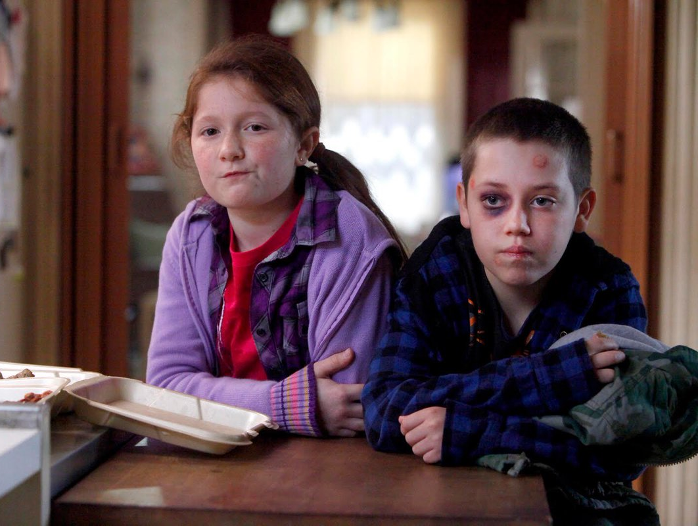
Amanda and Jonathan
Siblings in alternative class
Amanda, 9 Jonathan, 8
both in grade 2
First to offer help
Low income, 2 of 6 siblings
Severe speech delays
Background of poverty, violence,
and trauma
Frequent DPJ involvement

Slide 10
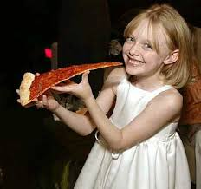
Kylie
11 years old, grade 5
Social
Anxiety, inability to focus
DPJ placement, infrequent visits
with mother

Slide 11

Skylar
Age 10, grade 4
Drawing comic strips
Severe depression and anxiety
Running away from class
Aggression towards students
and staff members
Two older brothers, DPJ involvement

Slide 12

Ricky
Age 10, grade 4
Building, legos
Anxiety, shutting down, refusal to return to class or go home
Father’s gambling addiction

Slide 13
Impacting Factors…

Slide 14

Low income area, low income families
Parents don’t have jobs or education
Parents addicted to substances
Exposure to domestic violence
Traumatic events in childhood
Single-parent families
Hindering Factors…

Slide 15
“Significant differences in separation anxiety, obsessive–compulsive, and conduct disorders were found between children who were exposed to domestic violence and those who were not” (McCloskey et al., 1995).

Slide 16
Helping Factors…
Access to extra curricular programs for free
Maison des Jeunes, Intervention workers
DPJ, counselling with families
Alternative learning environment, access to
one on one help from technician and teacher
Community Resources: 019P
Notes:
Research resources available to them in their community without cost such as the local maison des jeunes which has intervention workers, free extra curricular programs such as BOKS (fitness program ran by other students) and story & movie nights, families with frequent DPJ involvement may have counselling for the families, access to the BOOST class (alternative class)

Slide 17
After researching and getting to know the students, a program implementing mindfulness techniques seemed to be the most appropriate type of program for the students in this class!
Notes:
A frequency chart tracking behaviours with the times and dates of the behaviours was created during the observation process to get an idea of what the patterns surrounding the behaviours are. I spoke a lot with their technician and other staff in the school who knew the students to get a better idea of their backgrounds, needs and interests. I used some of my spare time to go outside at lunch and recess to try and build rapports with some of the students as these were mostly students who were not in cycle 1, which is the cycle I work in.
Visuals were necessary in a lot of the implementation as many of the students have ADHD and often cannot focus during lectures, they have more success when they have visuals and hands-on work to help them learn.
Clinical tools were used with / created by the students. The students already used clinical tools of their own, I brought in some that I had made and wanted to make some with them as well that they can keep even when school is over, and to help create a stimulating learning environment by using their interests and creativity to make their own tools.

Slide 18
“The results of bringing mindfulness into schools were overwhelmingly positive!” – McLeans, 2014, Toronto
“It would be beneficial to assess brief and effective mindfulness interventions for teachers to incorporate in their classrooms”- Mechanisms for mindfulness, 2006
“Meditation has been suggested as an alternative treatment for ADHD” – SAGE journals, 2008

Slide 19
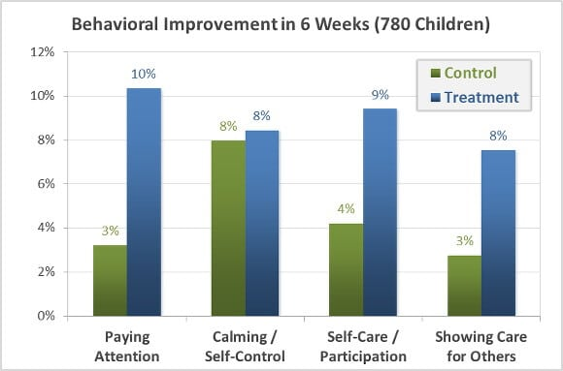
“In the 2011-12 school year, Mindful Schools partnered with the University of California, Davis to conduct one of the largest randomized-controlled studies to date on mindfulness and children, involving 937 children and 47 teachers in 3 Oakland public elementary schools” – Mindfulschools.org

Slide 20
“Studies find that youth benefit from learning mindfulness in terms of improved cognitive outcomes, social-emotional skills, and well being. In turn, such benefits may lead to long-term improvements in life. For example, social skills in kindergarten predict improved education, employment, crime, substance abuse and mental health outcomes in adulthood”
– Mindfulschools.org

Slide 21
In short…
Mindfulness techniques can be useful in reducing anxiety and aggressive behaviours for people of all ages
Implementing mindfulness techniques in participating schools has been effective at reducing aggression in the classroom
Clients can take what they learn with them, and use mindfulness techniques in their everyday lives, wherever they are

Slide 22

PLANNING AND
IMPLEMENTING
THE INTERVENTION
019A8
Notes:
Techniques used to plan intervention:
I wanted to go with a client-centred approach for this intervention. I tried to design it to fit the clients’ needs as closely as possible so I could make it very personal and specific to them. I wanted to use things that would draw their interests (such as art activities as these students spend a lot of their free time creating and painting). I tried to use as many visuals as possible as these are very helpful for these students, according to their technician.

Slide 23
O
A
D
I
E
- Observe clients, gather important info:
frequency charts, interviewing staff, observe
Assess their needs and capabilities
Design and develop IP that fits their needs
Implement IP using info gathered and design tailored to meet clients needs and capabilities
Evaluate & reflect successes and challenges, changes to be made
Notes:
Needs: to learn techniques to help reduce aggressive behaviours
Capabilities: hands on work, stimulating activities, building, creating, art

Slide 24
S | Objectives will be explained along with the rules prior to beginning each session. Students will have the opportunity to ask questions
M | Sessions will be explained step by step, students will be given time frames for each step and redirected after time is up
A | Sessions were designed to be straight forward, grab the attention of clients involved, using learning styles they are familiar with
R | Students current learning styles (hands on, with visuals, stimulating creativity) are used for these sessions
T | Each objective will be evaluated at the end of the session, the overall goal will be evaluated at the end of the program, assessed by SCC with help from teacher and technician
Notes:
Needs: to learn techniques to help reduce aggressive behaviours
Capabilities: hands on work, stimulating activities, building, creating, art

Slide 25

Long term goal:
The students will use mindfulness techniques in school
Notes:
Evaluation: The students used mindfulness techniques during each session.
According to their classroom technician, the students continued to use some of the techniques and tools throughout the week and even at home for certain students. Because this was a short period of only five weeks, we cannot asses whether the students continue to use the techniques over the summer. By the end of the school year though, they had been using some mindfulness techniques that they had learned in the sessions.

Slide 26
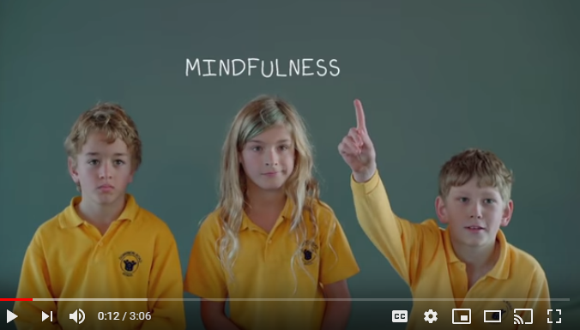
Session 1: Introduction Session
Objective: The students will explain what mindfulness is and why we are using it by the end of session
Introduction – question period - video https://www.youtube.com/watch?v=awo8jUxIm0c
Discussion with visuals – guided meditation for kids
Notes:
The session began with an introduction to mindfulness, followed by a question period where the students could explain what they think mindfulness is and why it is being implemented into their classroom. They then watched a video of children explaining what mindfulness means to them and had an opportunity to ask questions and discuss what they thought of the video.
Afterwards, I explained when the brain “flips the lid” using Dr. Diane Geharts methodology from her mindfulness program. I used a galaxy bottle that I had created with another student as part of my 019Tb assignment as a visual representation of what happens to the brain when we “flip the lid” or when our emotional brain takes over.
After the session, the students followed a three minute body scan video I had prepared on the smart board.
I had to be very patient and speak in a calming tone which was difficult as I am used to speaking loud in a classroom full of kids who are not focused and move around a lot so I can get their attention.

Slide 27
Relevance?
“Mindfulness is a meditation technique that is used to treat a number of mental health and physical conditions. When practiced regularly (5 minutes 5 days per week), this simple technique can effectively reduce symptoms of stress, depression, anxiety, addiction, and chronic pain” – Dr. Diane Gehart

Slide 28
Successes:
The students could explain what mindfulness is and why it’s being implemented into their class
Students were receptive and participated
Students were calm by the end of the session
Challenges:
Session went on much longer than intended
Students asked a lot of questions, not enough time for discussion

Slide 29
Session 2: Empathy and Sympathy
Objective: students will be able to explain the main difference between empathy and sympathy and why it is important to be empathic to others
Recap
Video - Brene Brown: https://www.youtube.com/watch?v=1Evwgu369Jw
Discussion
Activity AAA (019Ta)
Guided meditation
Notes:
The session began with a brief recap of the previous week (it should have been a more detailed recap as some of the students were different than the first session, I did not prepare for this outcome)
After the recap, the students were asked if they could explain what they think empathy and sympathy mean, and how they differ. Some students had a lot to say but did not understand the concept.
A video by Brene Brown on empathy vs sympathy was then shown followed by a discussion period after the video.
I then re arranged the room for an activity (I would have done it prior to session, though the students needed their desks in their regular spots for the intro and video). The AAA activity (appreciate, apologize, aha) took two to three turns to get the students to participate. I began by giving examples and went around the room. The teacher and technician participated and by the third round, all of the students said at least one thing.
The next step was another guided meditation video to end the session. Due to technical difficulties with the smart board, this did not work and got the students more excited. I had to be flexible and change things up a little by redirecting them and using the chime bell to create a moment of zen. The session wasn’t very successful.
I had to evaluate my intervention afterwards and reflect on what I could have done better. In the future, I would always plan a more concrete, but still brief, introduction in case there are different or new clients. I also felt that I was not zen enough. I tend to speak loud and sometimes quickly when I’m presenting something and because of how the session was going, I was becoming nervous and making some last minute changes, so I didn’t focus enough on speaking with a low tone in a slower manner. This is something I had difficulty with in both sessions that I would definitely improve on when running this type of sessions in the future.

Slide 30
How is this relevant to the issue?
“Through empathy, students learn to understand each other, which helps them to build friendships based on positive relationships of trust. ”
- Bob Sornson, Edutopia.org

Slide 31
Successes:
Participation for some students during entire session
Participation of all students during activity (second time)
Challenges:
Students did not fully grasp concept
Many students fooled around and did not listen
Smart Board was not working
Students were not calm by the end of session

Slide 32
Session 3: Zones of Regulation
Objective: The students will be able to identify the four zones and a strategy that they can use when they are in each zone
Brief recap
Discussion period – what are the Z.O.R. ?
Explanation
Activity (019Ta)
Strategies and Solutions posters
Notes:
This session began with a very brief recap of the first two sessions and like the other two, was followed by asking the students what they think the topic of todays session means before going into detail – the students were asked what they think the zones of regulation are.
After the discussion period, I used visuals (colored galaxy bottles also made with other students for an activity I had implemented) to describe each of the zones of regulation. I used examples to try to help them relate such as traffic lights (green means good to go, yellow means slow down, red means stop!).
This was followed by an activity: I had created a board with the four colors of the zones of regulation and cut out different emotions and feelings. The students were asked one by one to come up, grab a card and place it where they think it goes on the board. The students were told that there are no wrong answers and some feelings can go in more than one box. After they were done, I invited them to explain why they think a certain feeling went in the zone they chose. We went through each feeling and why it fits the zone it is in and how it can fit another.
Afterwards, I asked the students what kind of things they can do when they are in each zone and then showed them a poster with ideas and strategies for each zone. The posters were left on the wall in the classroom for a few days after the activity until they needed the space for another project.
We ended the session with the chime bell. I had wanted to end each session with a guided meditation video, but I wanted to be prepared for technical difficulties so I made sure I didn’t need to use any videos for this session.

Slide 33
How is this relevant to the issue?
These students have been unable to identify their emotions and regulate them. This session teaches them the basics and gives them techniques they can use when they are in certain zones.

Slide 34
Successes:
Students identified the zones & some emotions for each zone
Students participated well in activity
Students could give examples of solutions to undesired emotions
Challenges:
A little too long for some students – needed to walk around
One student spoke a lot more than others

Slide 35
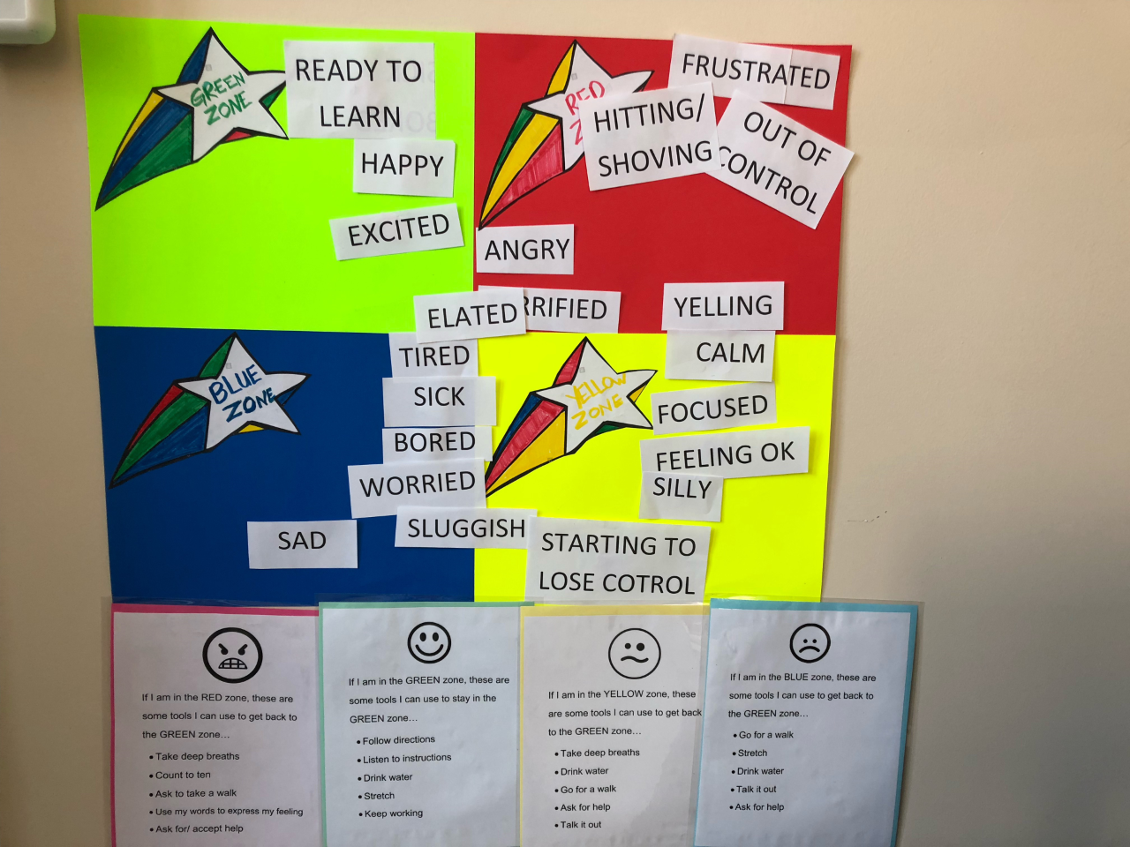

Slide 36
Session 4: DIY Clinical Tools 019Tb
Objective: The students can explain how they can use certain sensory tools and will create their own
Introduction to sensory tools
Re-arrange room for activity
Activity- DIY sensory tools (019Ta + 019Tb)
Chime bell meditation
Notes:
The session began with an introduction to clinical tools and what they can be used for. Some students wanted to share some of the tools that they have used at school or for some, in their group homes or during therapy.
I moved some of the desks around and placed a work table from the corner to the middle of the room so the students could all work on their tools together. This got a little tight, so I separated the students and asked if the technician and teacher could help by taking a pair of students each. We created our tools and cleaned up after. The students were very participant and excited to do the activity. I had described the tool as a fidget as well as a scented tool to help them calm down. A few moments after the tools were made, I had to retract and say they should only be used as a scented tool as the students were breaking them and we needed to remake some. When I had made my sample, I played with it a bit but I did not consider that a group of elementary students would probably be more rough with them and some broke. A student said the following few days that he had slept with it under his pillow and it helped him sleep, so there was some success after the sessions.
The session ended with the chime bell. I wanted to avoid technical difficulties again and the chime bell seemed to work well after the first few sessions. I’ve also used it in other classes and it worked better at calming the children than I had expected.

Slide 37
How is this relevant to the issue?
These students focus best when doing a hands-on activity. This activity is fun, colorful, and stimulates their senses – it has a grainy texture, a calming scent (lavender or chamomile), and a choice of a popping color

Slide 38
Successes:
Students could explain concept
Students could give examples of tools they can use
Students participated well in activity
Students gave positive feedback after activity & continued to use
tools at home and at school
Students were calm and relaxed at the end of session
Challenges:
Technology not working again
Bags began to break, should have said only scent and not fidget

Slide 39
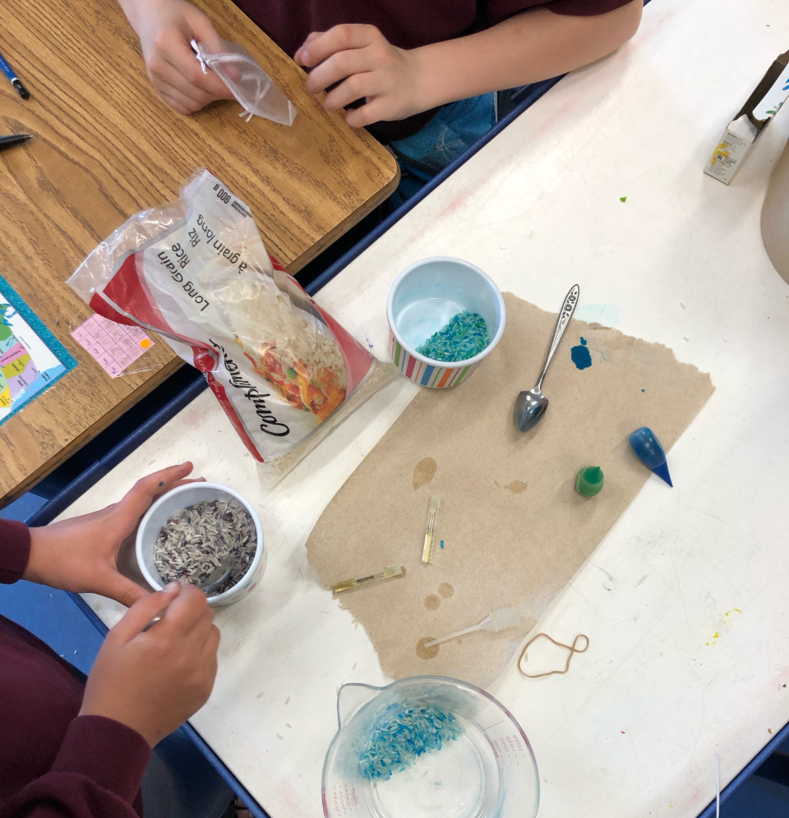
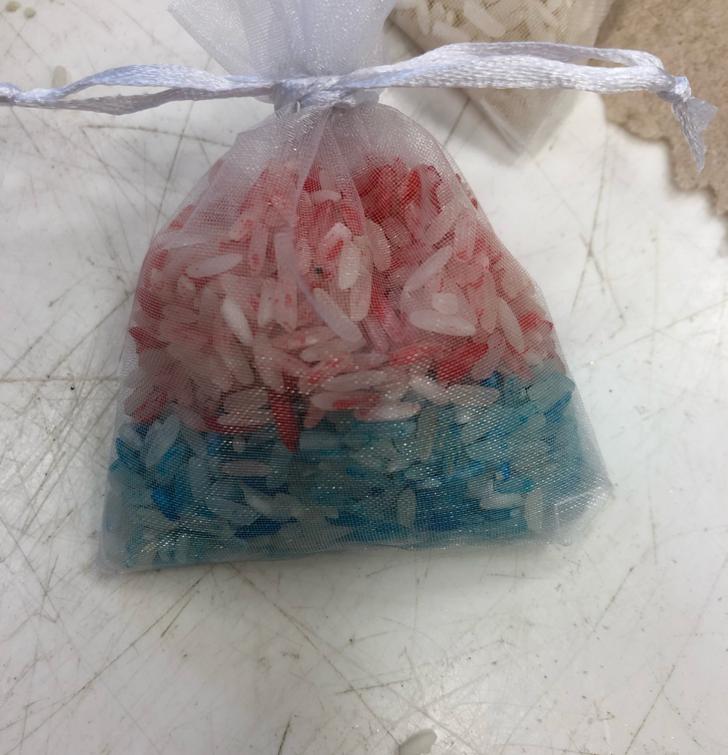

Slide 40
Session 5: Grounding Rocks Painting
Objective: The students will be able to identify a word that they can use to calm down in moments of stress or anxiety. They will paint a rock with this word
Present grounding rock
Discussion period
Activity- painting the rocks (019Ta + 019Tb)
Chime bell meditation
Notes:
I intended for this session to be done outside in the school yard. I wanted them to paint outside and listen to the sounds of nature and feel the breeze but due to the rain, I had to quickly change the plan and run the session indoors.
I went over the rules (we are to focus on the purpose and paint the rocks, not play with them or throw them, or touch anyone else's), then showed the students a sample rock and explained what it was: that it is to hold and focus on to help stay grounded, and that there is a word on it that can be a positive affirmation, something positive that they can focus on as well such as “breathe” or “believe”.
After the activity while the rocks were drying, I used the chime bell for a moment of calmness.
I had to be flexible for this activity as I wanted it to be an outdoor one and this was not possible that day. We were fortunate that the classroom had a sink and art supplies, otherwise I would have had to organize to use the cafeteria and ensure that we did not go over time as it would be used for other students, I would have also had to supply the paint and paint brushes. As in the other sessions, I had to evaluate my tone and presentation. By the last two sessions I spoke low and zen but this is something I will still require a lot of practice as an SCC as I am used to being in hectic situations and I am naturally a loud person.

Slide 41
How is this relevant to the issue?
These students often request painting and hands-on activities.
Painting can have calming effects, and the words chosen for the rocks can be considered positive affirmations, something these students could have more of in their lives.

Slide 42
Successes:
Students could explain concept
Students could identify a word with meaning to them
Students were calm and focused by the end of the session
Challenges:
Change of environment due to weather
Students fooled around and needed frequent redirection

Slide 43

Recommendations and things to take away from experience…
Think on your feet, be prepared for any outcome
Always have a backup plan
Use ice breakers more often
Allow more time for discussions
Have lots, lots, and lots of patience
Don’t beat yourself up if things don’t
go as planned
Allow times for follow ups to better evaluate success
These things take a lot of time and dedication, changes won’t happen over night
These can be a hit or miss- and that’s OK!
Notes:
I evaluate the success of the intervention by assessing and comparing the students at the beginning and end of each session, as well as the comparing the first and last sessions. I also spoke with the technician and teacher of the classroom and asked for any feedback. The changes were not drastic as the amount of time was limited and these are very lengthily processes, though the students were more focused and calm by the end of the sessions than the beginning. According to the technician, the students would talk about the sessions in the following days and asked if they could use the strategies and tools in class, some students used them at home as well. The students also stopped me a lot in the hallways and asked if we could continue the program next year as they enjoyed it and some said it helped them.
I would have kept track and created charts to evaluate the decrease in aggressive behaviours in the class from the beginning of the program to the end. There were different factors that could have played a role in the small changes of behaviours, so it is difficult to say how much of an impact the sessions actually had vs all the factors that could be considered. Having left time for more concrete follow ups would have also been beneficial in evaluating the success of the sessions. If I have the opportunity to run similar sessions in the future, I will want to start closer to the beginning of the school year so I have the time to really evaluate any changes in behaviours over the months. I would also begin each session with an ice breaker- I realized this during the presentation of another candidate and wish I had thought of it during my intervention plan, especially since I was working with many students I hadn’t really worked with before.
It took a bit of time for me accept that the sessions may not always go well, and after the second session I beat myself up over it a bit and felt discouraged until I spoke with the teacher a few days later and he said the session was good, it was just an off day for them. This is something I considered in the following sessions and something I will continue to improve as an SCC, sometimes things are a bit wonky and it is a learning experience. I will use that to improve that type of session if I can ever do them again in the future.

Slide 44

Some positive feedback…
Students looked forward to sessions
Some students continued to use techniques and tools at home
Students asked about ways they can use mindfulness when stressed
Some students asked if we can continue next year
`

